Slide 1
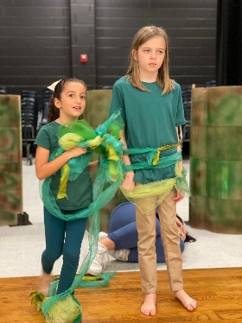
Advanced Acting Camp
Take your acting to the next level!
Dates: M-F 6/16/2025 to 6/27/2025
11:00 am to 3:00 pm
At League City Intermediate School
Ages - outgoing 6-8th grade
We will create a full One Act Play at the end of the camp.
Teacher recommendation required. Teachers may email
Sbrownfield@ccisd.net with recommendation.
Experience the LCI acting process under the direction of Shelley Brownfield-Hayden.
Students will not just act but make design and directorial choices.
This is Advanced Acting – Actors must be willing to memorize lines quickly and
work well with a team.
Team members are expected to give more to the artistic process than they get.
The focus is on the end product and our experience together.
Camp may be canceled if minimum number of students is not met.
Goal is 20 camp members.
Casting will be decided on the first day of camp.
Memorization deadline is second Monday of camp.
Tuition for this amazing camp is just $425
Scan QR code to
Visit our website
www.upstagearts.com
Need more info? Contact
Michael Ward at
Upstagearts@upstagearts.com
Or 832-797-4209
NEITHER THIS ORGANIZATION NOR THIS EVENT IS SPONSORED, ENDORSED
OR OTHERWISE AFFILIATED WITH CLEAR CREEK ISD.

